Slide 1
National Association of Catholic Nurses, U.S.A.
Meet & Greet
Diocese of [Name, State, date]
[Parish where event held]

Slide 2
Let Us Pray

Slide 3
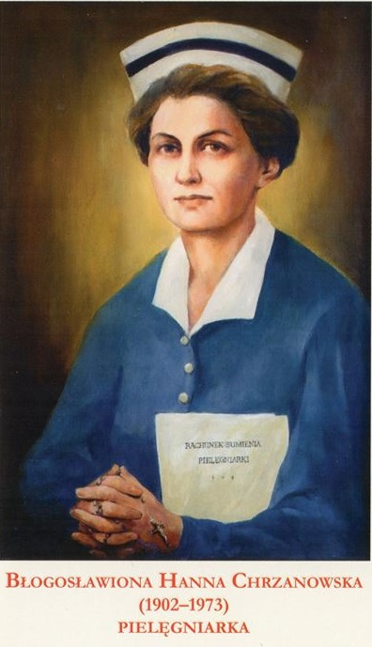
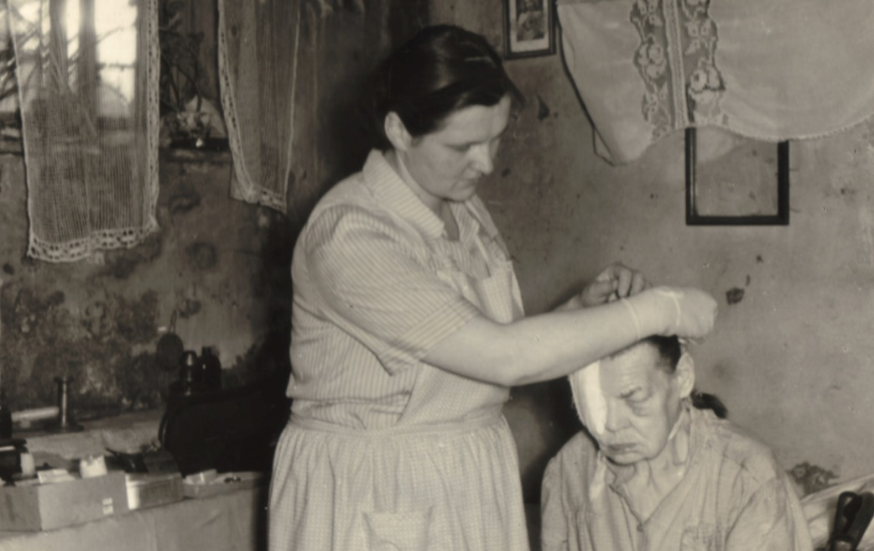
“We thank you Miss Hanna that you were among us...an embodiment of Christ’s beatitudes from the Sermon on the Mount, especially the one saying – ‘Blessed are the merciful.’ Those who knew Hanna well all testify that she heroically obeyed the Greatest Commandment of all – to love God with all her heart and her neighbor”.
Karol Cardinal Wojtyla, Homily at Hanna’s funeral mass
Bl. Hanna Chrzanowska, RN
https://hannachrzanowska.pl/en/
Beatified April 28, 2018 at the Sanctuary of Divine Mercy, Krakow, Poland

Slide 4
Thank You,
Bishop [Name of Your Bishop]
Diocese of [Name of Diocese]
[Insert picture of your bishop]

Slide 5
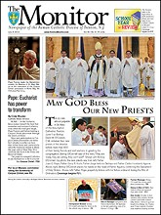
5/28/2013 National Association of Catholic Nurses-USA plans meet, greet
To encourage Catholic nurses of the Diocese of Trenton to consider forming a local council, St. Vincent de Paul Parish, Yardville, will hold a meet and greet for the National Association of Catholic Nurses, U.S.A. June 15 from 9:30 a.m. to noon in the church at 555 Yardville-Allentown Road. The NACN allows Catholic nurses to be grounded in their faith while supporting their patients and respecting their faith practice. It focuses on educational programs, spiritual nourishment, patient advocacy, and the integration of faith and health. Dr. Marie Hilliard, President-Elect of the NACNUSA and the Director of Bioethics and Public Policy of the National Catholic Bioethics Center will be the guest speaker. The history, mission and professional opportunities associated with the NACN will be discussed. The event is open to all nurses, nurse practitioners, student nurses, health paraprofessionals and other health practitioners. For information, email Maria Arvonio at elishaspirit2003@ yahoo.com or Patricia Sayers at sayers.patricia@ymail.com. The Monitor, 701 Lawrenceville Road, P.O. Box 5147, Trenton, NJ 08638-0147 | PHONE: 609-406-7404 | FAX: 609-406-7423 | Monitor@DioceseofTrenton.org Copyright © 2011 | TrentonMonitor.com | All Rights Reserved. Software © 1998-2013 1up! Software, All Rights Reserved
[Insert on this page any article published in Diocesan Newspaper]

Slide 6
History
Guild of St. Radegone for Nurses, Boston, MA
1924 International Catholic Guild of Nurses (ICGN), Milwaukee, WI, Fr. Edward J. Garesche,
S.J., Spiritual Director
1928 Several nurses from across the world meet in Basel, Switzerland
1933 1st International Committee of Catholic Nurses (now CICIAMS) met in Lourdes, France
ICGN adopted a “national character” → “National Federation of Catholic Nurses
CICIAMS 2nd meeting, Rome;
His Holiness Pope Pius XI, “…it is the duty of every Catholic nurse to belong to Catholic associations of nurses and to promote them in every way possible.”
1937 3rd meeting, London
His Holiness Pope Pius XI, “…The exercise of the profession of nurse is surely one of those which offer the greatest possibility for the apostolate, but we must not forget that the nurse, in the exercise of her profession, has to employ all sorts of technical means, and lives in a materialistic atmosphere, exposed to the danger of a limited interior piety only, dissociated from the profession and exterior practices enjoined by the Church. Furthermore, modern theories seek to penetrate the minds of Catholic nurses and to make them become unconsciously strong agents for the propagation of eugenics and neo-Malthusianism. It is necessary, then, to protect them by means of Catholic Action, which has for one of its duties to sustain and fortify them in their professional and Christian formation.
(Reference page 5, Conference Report, Excerpt from Pope Pius XI address)

Slide 7
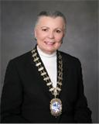
History
1940’s National Council of Catholic Nurses (NCCN-USA) formed – Active Local & Regional Councils formed across the nation in 112 Diocese with 22,000 members
1970 - NCCN disbanded - Local Councils flourish in the USA: Youngstown, OH (1945), Albany, NY (1946), Chicago, IL (1954), Libertyville, IL (1991)
- NACN-USA formed and incorporated in the Illinois with
Bishop Imesch, Diocese of Joliet serving as Spiritual Advisor
1994 NACN-USA voting member of CICIAMS
Approved US Conference of Catholic Bishops
for inclusion in the Official Catholic Directory
under the Diocese of Joliet
Councils formed and are forming across the nation
Contact your regional director for help forming a local council at the email below.
President Emeritus CICIAMS
(awarded by The Holy See in 2017)
Member, Pontifical Council for the
Pastoral Assistance of Health Care Workers appointed by Pope Benedict XVI, 2011-2017
CICIAMS President, 2007-2012
2nd President, NACN-USA, 1996-1998
Founding Member NACN-USA, 1993 which succeeded ICGN-1924 & NCCN-1940’s

Slide 8
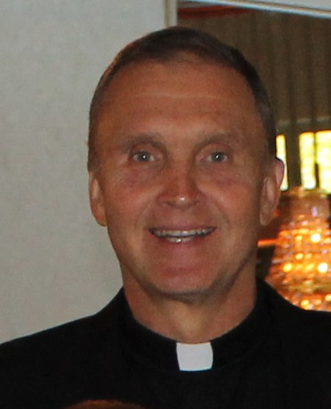
Thank You
[Local Pastor]
[Church Where Meet & Greet Held]
[Address] [City, State & Zip Code] [Phone & Fax & Email]
A Parish of The Roman Catholic Diocese of [Name of Diocese]

Slide 9
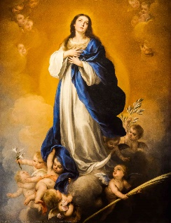
National Association of Catholic Nurses, U.S.A. Where NURSING, MINISTRY and CATHOLIC MISSION meet “Unity in Charity”
Mission: The National Association of Catholic Nurses, U.S.A gives nurses of different backgrounds, but with the same Roman Catholic values, the opportunity to promote moral principles within the Catholic context in nursing and stimulate desire for professional development. This approach to Roman Catholic doctrine focuses on: *Educational programs, *Spiritual nourishment, *Patient advocacy and *Integration of faith and health.
As we continue to share our faith and values with each other, and with other healthcare providers, we simultaneously reach outward to the larger Church and also our communities, as we offer support to those in need.

Slide 10
National Association of Catholic Nurses, U.S.A. Where NURSING, MINISTRY and CATHOLIC MISSION meet “Unity in Charity”
Objectives:
To promote education in Catholic nursing ethics.
2. To nurture spiritual growth.
3. To provide guidance, support, and networking for Catholic nurses and nursing students, as well as other healthcare professionals and non-healthcare professionals who support the mission and objectives of the NACN-USA.
4. To advocate for those in need through efforts which integrate faith and health.
(NACN-USA Bylaws, Article IV)

Slide 11
National Association of Catholic Nurses, U.S.A. Where NURSING, MINISTRY and CATHOLIC MISSION meet “Unity in Charity”
Motto: Unity in Charity
Patroness:
Our Lady of the Immaculate Conception
Tag Line
Where NURSING, MINISTRY and CATHOLIC MISSION meet

Slide 12
National Association of Catholic Nurses, U.S.A. Where NURSING, MINISTRY and CATHOLIC MISSION meet “Unity in Charity”
Membership / Dues
$50/year recurring or one time payment; join online
General, Constituent
Catholic nurses residing in the United States or its territories. Constituent
members also have a local council to which they belong. $10 refund/member.
Associate - Non-Catholic nurses & other non-nursing healthcare professionals who accept Roman Catholic values & moral principles within the context of nursing.
Student - Pre-licensure nursing students attending an accredited nursing program in the United States or its territories. FREE membership.
Honorary - Any person who has aided in the foundation, development, or activities of the NACN-USA, or an affiliated Council, in any outstanding manner.

Slide 13
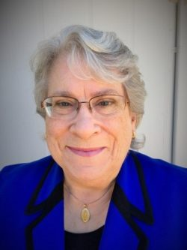
National Association of Catholic Nurses, U.S.A. Where NURSING, MINISTRY and CATHOLIC MISSION meet “Unity in Charity”
President
Ellen Gianoli, BSN, PHN, MA (Theology), RN
Ellen is a seasoned Catholic nurse with a variety of experiences that span staff nurse, charge nurse, public health nurse, department head, hospital educator and college nursing educator. She understands the concerns of nurses to remain morally sound within the intensely changing healthcare environment.
Assumes Presidency July 1, 2020 – June 30, 2022

Slide 14
National Association of Catholic Nurses, U.S.A. Where NURSING, MINISTRY and CATHOLIC MISSION meet “Unity in Charity”
Priest Chaplain
Rev. Michael G. Whyte West Simsbury, Connecticut
Appointed on July 31, 2013 by the Most Reverend R. Daniel Conlon, Bishop of Joliet with the acknowledgement and approval of the Most Reverend Henry J. Mansell, Archbishop of Hartford, and at the recommendation of the NACN-USA Board of Directors.

Slide 15
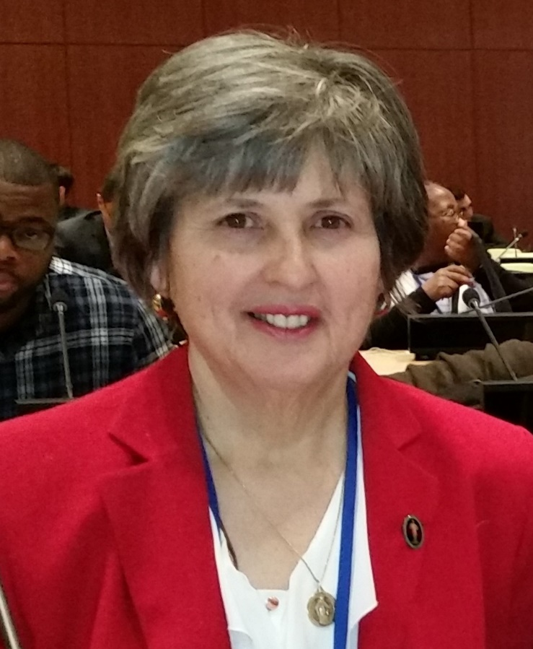
National Association of Catholic Nurses, U.S.A. Where NURSING, MINISTRY and CATHOLIC MISSION meet “Unity in Charity”
Regional Director
Lower Northeast (LNE) – Region 2
Maria Arvonio, RN, BSN, MA
New Jersey
Elected to BOD 2016. BSN from Villanova University and Master in Healthcare Ethics from St Joseph’s University. Experience in Critical Care and Emergency Nursing. Nursing supervisor currently. Published in Linacre Quarterly Journal Feb 2014, “Cultural competency, autonomy, and spiritual conflicts related to Reiki/CAM therapies: Should patients be informed?”
INSERT YOUR PICTURE
AND CONTACT INFO

Slide 16
National Association of Catholic Nurses, U.S.A. Where NURSING, MINISTRY and CATHOLIC MISSION meet “Unity in Charity”
Board of Directors
Officers:
President
President Elect
Recording Secretary
Corresponding Secretary
Treasurer
Regional Directors:
Upper Northeast (UNE)
Lower Northeast (LNE)
MidAtlantic (MA)
Southeast (SE)
NorthCentral (NC)
SouthCentral (SC)
MidWest (MW)
SouthWest (SW)
Pacific (PA)

Slide 17
National Association of Catholic Nurses, U.S.A. Where NURSING, MINISTRY and CATHOLIC MISSION meet “Unity in Charity”
Nine Regions
CatholicNurses@nacn-usa.org
Region 1 – Upper Northeast (UNE)
Connecticut, Vermont, New Hampshire, Maine, Massachusetts and Rhode Island.
Regional Dir. P. Renee Frost, BSN, RN, CCM
Rocky Hill, CT
Region 2 – Lower Northeast (LNE) New York, New Jersey, Pennsylvania, Delaware, Maryland, Washington, D.C.
Regional Dir. Maria Arvonio, BSN, MA (HCE), RN
Trenton, New Jersey
Region 3 – MidAtlantic (MA) Michigan, Ohio, Indiana, Virginia, West Virginia, Kentucky Regional Dir. Janet Munday, BSN, RN
Wapakoneta, Ohio
Region 4 – Southeast (SE) Alabama, North Carolina, South Carolina, Tennessee, Georgia, Florida, Virgin Islands, Puerto Rico
Regional Dir. Alma Abuelouf, BSN, RN
Memphis, TN
Region 5 – NorthCentral (NC) Minnesota, Iowa, Missouri, Illinois, Wisconsin, Nebraska, Kansas
Regional Dir. Jan Salihar, RN, CCM, Wheaton, Illinois
Region 6 – SourthCentral (SC)
Texas, Oklahoma, Arkansas, Louisiana, Mississippi
Regional Dir. Margaret “Peggy” Humm, MSN, APRN,
CNS-MCH, San Antonio, TX
Region 7 – MidWest (MW) North Dakota, South Dakota, Montana, Idaho, Wyoming
Regional Dir. Vacant
Region 8 – SouthWest (SW) Nevada, Utah, Colorado, Arizona, New Mexico
Regional Dir. Vacant
Region 9 – Pacific (PA) Washington, Oregon, California, Alaska, Hawaii, Guam, Northern Mariana Islands & American Samoa
Regional Dir. Vacant
If you would like to serve in a leadership position, contact Suzanne Gullotta, Chair, Membership & Elections Committee: sudangullotta@hotmail.com or CatholicNurses@nacn-usa.org

Slide 18
National Association of Catholic Nurses, U.S.A. Where NURSING, MINISTRY and CATHOLIC MISSION meet “Unity in Charity”
Committees
Awards & Scholarships
Bylaws
Communications
Education, Practice & Research
Ethics & Spirituality
Membership & Elections
Archives & History (ad hoc)
Finance (ad hoc)
Volunteer to Serve at:
https://nacn-usa.org/about-us/volunteer-committee/

Slide 19
National Association of Catholic Nurses, U.S.A. Where NURSING, MINISTRY and CATHOLIC MISSION meet “Unity in Charity”
Contact / Social Media
Website: https://nacn-usa.org/
Facebook: https://www.facebook.com/catholicnurses
Twitter: @CatholicNurses
Email: CatholicNurses@nacn-usa.org
YouTube: https://nacn-usa.org/about-us/

Slide 20
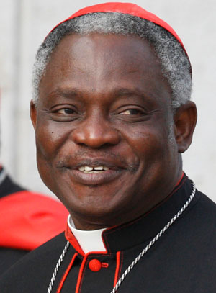
The Vatican Dicastery for Promoting Integral Human Development
Pope Francis instituted a new dicastery effective
January 1, 2017.
Four Pontifical Councils were merged:
Pontifical Council for Justice and Peace
Pontifical Council Cor Unum
Pontifical Council for the Pastoral Care
of Migrants and Itinerant People
Pontifical Council for the Pastoral
Assistance to Health Care Workers***
Healthcare issues are now addressed under the auspices of the Dicastery for Promoting Integral Human Development (IHD)
led by Peter Kodwo Appiah Cardinal Turkson.

Slide 21
The International Catholic Committee of Nurses and Medico- Social Assistants (CICIAMS)
(Comité International Catholique des Infirmières et Assistantes Médico-Sociales)
1933 – After meeting at Basel, Switzerland in 1928, several Catholic Nurse Associations met at Lourdes, France forming what would be known as CICIAMS. ***Medico-social Assistant is the title for APN in Asia who were not allowed to use the title “nurse.”
1935 – Rome – His Holiness Pope Pius XI addressed 2000 nurses
1937 – London - Through his spokesperson Cardinal Pizzardo in a 1938 letter to the Bishops, Pope Pius XI shared that, “It is the duty of every Catholic Nurse to belong to Catholic associations of nurses and to promote them in every way possible.”
CICIAMS headquarters is in Vatican City. NACN-USA is a country members of CICIAMS. CICIAMS GENERAL SECRETARIAT, Palazzo San Calisto (Piazza San Calisto 16), 00120, Vatican City, Phone: +390669887372.
Notes:
Medico-Sociales or Medical Social Assistants were the European equivalent of an Advance Practice Nurse.

Slide 22
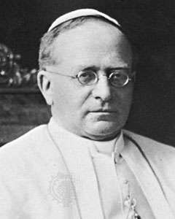
Rome 1935 – His Holiness Pope Pius XI addressed 2000 nurses:
struggle against "paganism and materialism which insinuated themselves everywhere in order to cast out Christ"
“be first and foremost, and at any cost, full of the spirit of spirituality, of Christianity, of the Christian supernatural."
"bring material, bodily comfort..."
"be outstanding nurses, technically speaking, you will have to continue improving on what you do, and keep abreast of all that you ought to know."
www.nacn-usa.org / CatholicNurses@nacn-usa.org/ @catholicnurses
Notes:
Medico-Sociales or Medical Social Assistants were the European equivalent of an Advance Practice Nurse.

Slide 23
CICIAMS
The International Catholic Committee of Nurses and Medico-Social Assistants –
Comité International Catholique des Infirmières et Assistantes Médico-Sociales
Our Aims are:
• To unite Catholic Nurses in promoting their technical skills in accordance with Christian principles.
• To co-operate in the development of nursing and other medico-social issues.
• To be witnesses of Christian values in international agencies.
• To undertake all possible means to realize these aims.
Through these aims CICIAMS requires Catholic Nurses to be seen to join together in promoting a Christian, moral approach to care.
Notes:
Assistantes Medico-Sociales were the European attempt to create an Advance Practice Nurse category.

Slide 24
There are now more than 60 member countries divided into 5 Regional Secretariats:
1. Africa - English speaking regions
2. Africa - French speaking regions.
3. Asia
4. North America
5. Europe
The International Secretariat is currently based at:
CICIAMS GENERAL SECRETARIAT, Palazzo San Calisto (Piazza San Calisto 16), 00120, Vatican City, Phone: +390669887372

Slide 25
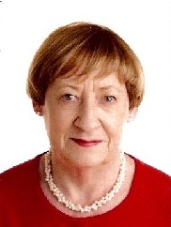
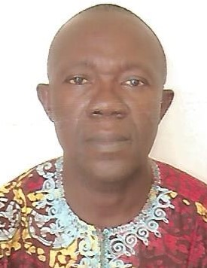
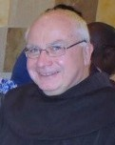
International President
Geraldine Mc Sweeney
Ireland
Secretary General
Donatus Akpan
Nigeria
International Ecclesiastical Assistant - Ex Officio
Fr. Thomas Nairn, OFM, PhD

Slide 26
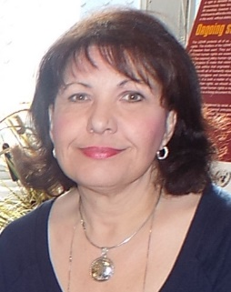
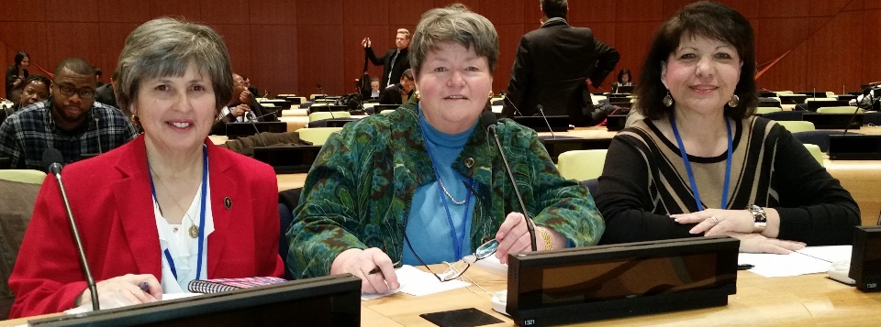
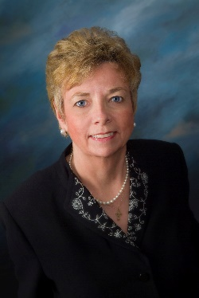
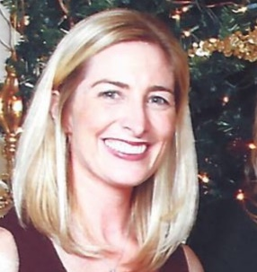
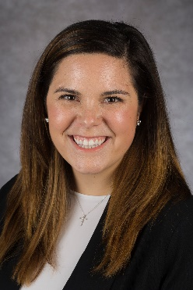
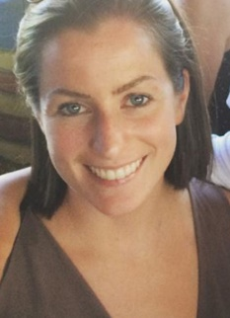
Pan American President
Marian (Mimi) Nowak, DNP, MPH, RN, CSN, FCN, FAAN
New Jersey
Chair, Ethics Committee
Marie Hilliard, MS. MA, JCL, PhD, RN
Washington DC
Member Committee on the Family
Shannon Simonovich, PhD, RN
Illinois
United Nations Representatives:
Maria Arvonio, BSN, MA (HCE), RN
Patricia Sayers, DNP, RN
Marian Nowak, DNP, MPH, RN, CSN, FCN, FAAN
UN Youth Members:
Courtney Donahue, DNP, RN, FNP-BC, PCCN
Sarah Donahue, BSN, RN
Notes:
These are NACN-USA members holding CICIAMS positions in 2018

Slide 27
National Association of Catholic Nurses, U.S.A. Where NURSING, MINISTRY and CATHOLIC MISSION meet “Unity in Charity”
7th Congress of English-Speaking African Region of CICIAMS
Theme: Embracing Nursing Leadership in Non-Communicable Disease Management to Enhance Holistic Care
Date: 9-11 Sept. 2020; Excursion 12 Sept. 2020
Location: Nairobi, Kenya
Note: CICIAMS Board and NACN-USA Representatives meetings --- Executive Board 7Sep; General Council 8Sep; Meetings for Election purposes 9 or 10 Sep evening
Register: https://nacn-usa.org/news-events/nacn-usa/

Slide 28
National Association of Catholic Nurses, U.S.A. Where NURSING, MINISTRY and CATHOLIC MISSION meet “Unity in Charity”
XXI CICIAMS World Congress
Date: August 2-4, 2022; Executive Council Meeting July 31; General Council Meeting, August 1, 2022
Location: Villanova University, Pennsylvania
Fundraising: Donations at https://www.nacn-usa.org Indicate “XXI CICIAMS World Congress donation.”
Consider arranging a designated offering to support the World Congress in the U.S.A. (Thank you!)

Slide 29
National Association of Catholic Nurses, U.S.A. Where NURSING, MINISTRY and CATHOLIC MISSION meet “Unity in Charity”
Why Join NACN-USA?
Be part of the Catholic Nurse Voice
Spiritual and Ethical Insights
Opportunities to Serve as a Leader or Committee member Locally and in a National and International Organization
Professional and Social Networking
Affirm our Catholic position on the Dignity and Value of all Human Life

Slide 30
National Association of Catholic Nurses, U.S.A. Where NURSING, MINISTRY and CATHOLIC MISSION meet “Unity in Charity”
Activities of NACN-USA
on behalf of Catholic Nurses
National and Regional Meetings
2013 & 2014 – Aquinas College, Nashville, TN
2016 – Loyola University, Chicago, IL
2017 – Cape Cod, MA
2018 – San Antonio, TX
2020 – Hanceville, AL, June 16-18***
Opportunities Abroad
Catholic Health Links
Networking and Educational Opportunities
Local Council Formation Assistance***
Notes:
In the next nine slides, I will provide a quick overview of some activities of the National Association of Catholic Nurses, U.S.A. on behalf of Catholic Nurses.
Current the NACN-USA holds an educational meeting. Our next one will be August 2-3 in San Antonio, Texas.
On our website you can find opportunities to serve as a nurse in missions abroad. These are not sponsored by NACN-USA but have been reviewed for faithfulness to Church teaching.
There are Catholic Health Links and Resources
We provide networking and Educational Opportunities. In addition to the NACN-USA Conference, there are Regional Council meetings and we share offerings provided us by other organizations with similar values.

Slide 31
National Association of Catholic Nurses, U.S.A. Where NURSING, MINISTRY and CATHOLIC MISSION meet “Unity in Charity”
Regulatory (HHS / FDA)
FDA – Find Alternatives to Immunizations Grown in Aborted Fetal Cells - 2019
Removing Barriers to Participate in HHS Programs (Joint letter) – Nov2017
January2018-HHS established a “Conscience and Religious Freedom Division” and a mechanism to File a Complaint
Rules on Religious & Moral Accommodations under the Affordable Care Act (ACA) – Dec17 --- Final rule issued 7Nov2019
Notes:
In May we collaborated with the Campaign for Truth in Advance Care Planning asking then Secretary Price of the Department of Health and Human Services to oppose the Pew Charitable Trusts proposal to requires Physician Orders for Life Sustaining Treatment (POLST).
The PEW Trusts approach to Advance Care Planning is reckless and unjust. Under this approach health care costs are reduced by incentivizing providers to engage patients in advance care planning discussions that discourage treatment even if it might be beneficial to them. It requires that patient advance care planning documents, some being immediately actionable medical orders, be part of an electronic health record database that is instantly accessible across the health care system. This set in stone decisions made in advance of a problem and in the absence of context, which makes it difficult, if not impossible, to alter specific decision given real time circumstances. It further calls for the development of quality measures of these activities to which providers are held accountable and upon which payment decisions are made.
HHS Draft Strategic Plan -

Slide 32
National Association of Catholic Nurses, U.S.A. Where NURSING, MINISTRY and CATHOLIC MISSION meet “Unity in Charity”
To File a
Religious or Moral Complaint
www.hhs.gov/conscience/complaints/filing-a-complaint/index.html
Name the health care or social service provider involved
Describe the acts or omissions, you believe violated conscience or religious freedom laws or regulations
Electronically sign the complaint and complete the consent form.

Slide 33
National Association of Catholic Nurses, U.S.A. Where NURSING, MINISTRY and CATHOLIC MISSION meet “Unity in Charity”
U.S. Congress
Letter to Judiciary Committee expressing grave concerns with the “Equality Act” - 2019
Joint Letter to Congress urging the passage of the Conscience Protection Act of 2017
Joint Letter to Congress with 26 organizations urging the passage of the Conscience Protection Act of 2016
Notes:
Each year the National Association of Catholic Nurses, U.S.A. has supported the passage of the Conscience Protection Act along with many other organizations.

Slide 34
National Association of Catholic Nurses, U.S.A. Where NURSING, MINISTRY and CATHOLIC MISSION meet “Unity in Charity”
Continuing Education Award
California (CA) Board of Registered Nursing rescinded the award to CEUs for the Abortion Pill Reversal Program Education
NACN-USA joined Heartbeat International and the CA Conference of Catholic Bishops to challenge this administrative decision – Oct17
Dec2017 – CA BRN reversed their decision and again began awarding CEUs to educate nurses on this program which saves lives.
https://www.abortionpillreversal.com/
Notes:
In October 2017 Ellen Gianoli, BSN, MPH, RN, Pacific Regional Director brought to the attention of the NACN-USA BOD that the California (CA) Board of Registered Nursing (BRN) had rescinded its award of continuing education (CEs) to Heartbeat International for their course on Abortion Pill Reversal (APR). At the time, this course is taught by Debbie Bradel, RN, Nurse Manager of the APR Program in San Diego, California and a member of NACN-USA
President Diana Ruzicka and Ellen Gianoli met with the lawyers from the California Conference of Catholic Bishops in November. NACN-USA then joined Heartbeat International in their request for the CA BRN to continuing awarding CEs.
Dr. Carolyn Laabs, PhD, MA, FNP-BC, RN, Chair, Ethics and Spirituality Committee composed a letter requesting an administrative review which was sent to the CA BRN in November 2017.
The California Board of Registered Nurses has reversed their decision to rescind CEU’s from Heartbeat International’s Abortion Pill Reversal course [Read Article #1]. In a written letter sent Dec. 19, the California Board of Registered Nursing notified Heartbeat International that it can now grant continuing education units (CEUs) to nurses who study a life-saving process known as Abortion Pill Reversal [Read Article #2].
We thank the CA BRN for their thoughtful reconsideration.

Slide 35
National Association of Catholic Nurses, U.S.A. Where NURSING, MINISTRY and CATHOLIC MISSION meet “Unity in Charity”
ANA Positions Statement Comments
A Call to Action: Cultivating Moral Resilience and a Culture of Ethical Practice
Artificial Nutrition and Hydration
Ethical Responsibility to Manage Pain and Suffering
Nurses’ Role in the Care of Persons with Intellectual and Developmental Disabilities
Core Principles on Connected Health
The Nurses’ Role When a Patient Requests Aid in Dying
Nursing Care and Do Not Resuscitate Decision
The Ethical Use of Artificial Intelligence (AI) in Nursing Practice
Notes:
Last Year 2017 – NACN-USA provided comments to three position statements of the American Nurses Association.
In addition we joined with
AAPLOG=American Association of Pro-Life Physicians; ACP=American College of Pediatricians; CMA=Catholic Medical Association; CMDA=Catholic Medical and Dental Association; NCBC=National Catholic Bioethics Center
to petition the American Medical Association (AMA) to strongly denounce the World Medical Association (WMA)’s proposed change forcing physicians to refer for abortion and preform them when services were not available.
Early in 2017 at two separate times, we urged the AMA NOT to change their policy of opposition to physician assisted suicide. In June 2016 at the AMA annual meeting, the 540 members of the American Medical Association (AMA) house of delegates, representing all facets of the house of medicine, voted to ask the board of trustees to study the issue of physician assisted suicide. The board has referred the item to the AMA Council on Ethical and Judicial Affairs, which will conduct an in-depth literature review, and will ultimately report back to the house of delegates.

Slide 36
National Association of Catholic Nurses, U.S.A. Where NURSING, MINISTRY and CATHOLIC MISSION meet “Unity in Charity”
American Medical Association
Urged NOT to adopt a “neutral” position to “Physician Assisted Suicide” or “Medical Aid in Dying.” ← Sent to CEJA, each Officer and each member of Board of Trustees-Jun2019
Urged AMA to strongly denounce the World Medical Associations’ proposed change forcing physicians to refer for abortion and perform when services not available with AAPLOG, ACP, CMA, CMDA, NCBC -Feb2018
Urged that they NOT change their policy of opposition to physician assisted suicide-Aug2017 w/ colleagues & Feb2017
Notes:
Last Year 2017 – NACN-USA provided comments to three position statements of the American Nurses Association.
In addition we joined with
AAPLOG=American Association of Pro-Life Physicians; ACP=American College of Pediatricians; CMA=Catholic Medical Association; CMDA=Catholic Medical and Dental Association; NCBC=National Catholic Bioethics Center
to petition the American Medical Association (AMA) to strongly denounce the World Medical Association (WMA)’s proposed change forcing physicians to refer for abortion and preform them when services were not available.
Early in 2017 at two separate times, we urged the AMA NOT to change their policy of opposition to physician assisted suicide. In June 2016 at the AMA annual meeting, the 540 members of the American Medical Association (AMA) house of delegates, representing all facets of the house of medicine, voted to ask the board of trustees to study the issue of physician assisted suicide. The board has referred the item to the AMA Council on Ethical and Judicial Affairs, which will conduct an in-depth literature review, and will ultimately report back to the house of delegates.

Slide 37
National Association of Catholic Nurses, U.S.A. Where NURSING, MINISTRY and CATHOLIC MISSION meet “Unity in Charity”
Amicus Briefs
Cook v. Harding to US Court of Appeals for the 9th Circuit explaining the physical effects of gestational surrogacy on surrogate mother and their children.
Jointly signed amicus briefs opposing the HHS Contraceptive Mandate and its violation of religious freedom
AMICUS=Friend of the Court
Notes:
2015 - The NACN-USA jointly signed Amicus Briefs in opposition to the U.S. Department of Health and Human Services’ (HHS) employer Contraceptive Mandate. This Mandate violates the religious freedom of this faith-based organization by forcing it to be complicit in providing to its employees contraception, including abortifacient drugs and devices. In 2015 a panel of the District of Columbia Circuit Court of Appeals allowed a lower court’s ruling to stand, which denied religious freedom to Priests for Life. The Court also denied a request for a full court review of this case, compelling Priests for Life to face the choice of violating their faith or paying huge fines. Priests for Life petitioned the U.S. Supreme Court to intervene. Religious freedom is the bedrock of this democracy, and the foundation for our very existence as a country. NACN-U.S.A. recognizes that when the religious freedom of one group is violated by the law, all groups, including health care workers of conscience, are vulnerable to similar violations. NACN-U.S.A. is happy to be standing with Priests for Life in support of their religious freedom.
The NACN-USA also signed 6 other Amicus Briefs opposing the HHS Contraceptive Mandate and its violation of religious freedom in support of the Colleges here listed.

Slide 38
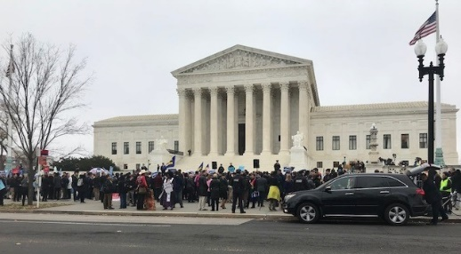
National Association of Catholic Nurses, U.S.A. Where NURSING, MINISTRY and CATHOLIC MISSION meet “Unity in Charity”
SCOTUS AMICUS Briefs
Masterpiece Cakeshop, LTD and Jack C. Phillips vs Colorado Civil Rights Commission
End Surrogacy Contracts which Treat the Child as a Commodity Similar to Human Trafficking
SCOTUS=Supreme Court of the United States
AMICUS=Friend of the Court
Notes:
The National Association of Catholic Nurse, U.S.A. has signed on to several “Friend of the Court” briefs. Two of these were petitioned to the Supreme Court of the United States (SCOTUS). On December 5th, 2017 SCOTUS heard the Masterpiece Cakeshop and Jack Phillips vs the Colorado Civil Right Commission. The question presented was “Whether applying Colorado’s public accommodations law to compel an artist to create expression that violates his sincerely held religious beliefs about marriage violates the Free Speech or Free Exercise Clauses of the First Amendment. Dr. Carolyn Laabs, PhD, MA, FNP-BC, RN, Chair, Ethics & Spirituality Committee represented the NACN-USA at the dinner hosted by the Phillips family and Alliance for Defending Freedom.
The Supreme Court refused to hear the surrogacy case. The NACN-USA does not support surrogacy contracts which treat children as a commodity similar to Human Trafficking.

Slide 39
National Association of Catholic Nurses, U.S.A. Where NURSING, MINISTRY and CATHOLIC MISSION meet “Unity in Charity”
International / United Nations
Urged UN Human Rights Commission not to exclude the unborn from a right to life and thus impose a worldwide right to abortion by signing C-FAM petition
Partnered with 6 organizations to provide testimony to the International Society for Stem Cell Research (ISCCR) on their draft 2016 Guidelines for Stem Cell Science and Clinical Translation.
https://nacn-usa.org/news-events/news/
Notes:
The NACN-USA and many members signed a C-FAM petition urging the United Nations Human Rights Commission (UN HRC) not exclude the unborn from a right to life and thus impose a world wide right to abortion.
The NACN-USA partnered with 6 other organizations to provide testimony to the International Society for Stem Cell Research (ISCCR) on their draft 2016 Guidelines for Stem Cell Science and Clinical Translation. Two critical provisions advocated for by this consortium were adopted. (2016)
Partner organizations: The National Catholic Bioethics Center (NCBC); the Catholic Medical Association (CMA); the National Catholic Partnership on Disability (NCPD); the American College of Pediatricians (ACP); and the Center for Family and Human Rights (CFHR).
See the NACN-USA website for more information at the NACN-USA News Tab. https://nacn-usa.org/news-events/news/

Slide 40
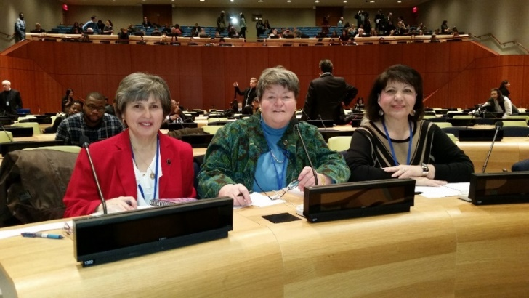
National Association of Catholic Nurses, U.S.A. Where NURSING, MINISTRY and CATHOLIC MISSION meet “Unity in Charity”
CICIAMS at the United Nations
Population & Development Commission
2020 – Strategies Addressing Global Hunger
2019 – 2030 Agenda for Sustainable Development
2018 – Sustainable cities, human mobility and international migration
2017 – Changing population age structures and sustainable development–Suppression of births over the last 50 years has resulted in cascading births and dangerous problems for millions of people…
2016 – Collection & Distribution of Demographic Data by the UN
2015 – Ethical and moral
consequences of the present
programs to limit births
around the globe
NACN-USA Members:
Maria Arvonio
Pat Sayers
Mimi Nowak
https://nacn-usa.org/news-events/nacn-usa/nurse-delegates/
Notes:
Currently Catholic Nursing is represented at the United Nations by
CICIAMS President, Geraldine McSweeney, RN
Dr. Patricia Sayers, DNP, RN (NACN-USA member and past Corresponding Secretary);
Maria Arvonio, RN, BSN, MA (HCE), (Lower Northeast Regional Director),
Dr. Marian Nowak, MPH, RN, CSN, FCN, FAAN (NACN-USA Member and CICIAMS Pan American President);
And Two (2) Youth Members
Courtney Donahue, MS, RN, FNP-BC, PCCN (NACN-USA Newsletter Editor) and
Sarah Donahue, BSN, RN (NACN-USA Member) along with
In 2015 Dr. Patricia Sayers presented a 3-minute testimony to the United Nations Population and Development Commission on the ethical and moral consequences of the present programs to limit birth around the globe. The United Nations has a goal to end poverty world wide. They can do this by decreasing consumption or increasing production. They have implemented many strategies to decrease consumption. Both International Catholic Nursing (CICIAMS) and Nigeria requested that they work on strategies to increase production.
In 2016 Maria Arvonio, BSN, MA (HCE), RN presented a 3-minute testimony expressing concerns for the United Nations plan to collect individual demographic data. A repository is being built outside Geneva to house this data. For what purpose it will be used has not been described.
In 2017 Dr. Mimi Nowak, DNP, MPH, FCN, FAN, FAAN, presented a 3-minute testimony under the heading of Changing population age structures and sustainable development. Due to the suppression of births over the last 50 years many countries are experiencing aging populations. The United Nations and governments are using extensive immigration to prevent economic collapse. This in turn has radically changed the cultures in various countries. CICIAMS recommended a return to fertility.
In 2018 Dr. Patricia Sayers, DNP, RN, presented a 3-minute testimony under the heading of Sustainable Cities, Disaster, Poverty and Violence.

Slide 41
Thank You

Slide 42
CICIAM
United States www.nacn-usa.us(64)
Argentina www.nacn-usa.com.ar(41)
Australia www.nacn-usa.at(93)
Israel www.nacn-usa.co.il(15)
Canada www.nacn-usa.ca(35)
United Kingdom www.nacn-usa.uk(74)
Belgium www.nacn-usa.be(35)
France www.nacn-usa.com.fr(14)
Belarus www.nacn-usa.by(47)
Indonesia www.nacn-usa.co.id(36)
Chile www.nacn-usa.cl(19)
www.nacn-usa.cc(37)
China www.nacn-usa.cn(54)
Colombia www.nacn-usa.com.co(82)
Costa Rica www.nacn-usa.co.cr(73)
Andorra www.nacn-usa.ad(46)
Cuba www.nacn-usa.cu(34)
Aruba www.nacn-usa.aw(25)
South Korea www.nacn-usa.co.kr(29)
United Kingdom www.nacn-usa.co.uk(61)
New Zealand www.nacn-usa.co.nz(32)
Ecuador www.nacn-usa.ec(26)
Thailand www.nacn-usa.co.th(72)
Bolivia www.nacn-usa.com.bo(42)
Brazil www.nacn-usa.com.br(38)
Japan www.nacn-usa.co.jp(71)
China www.nacn-usa.com.cn(26)
Mexico www.nacn-usa.com.mx(28)
Dominican Republic www.nacn-usa.com.do(17)
Australia www.nacn-usa.com.au(53)
Ecuador www.nacn-usa.com.ec(71)
Brazil www.nacn-usa.br(16)
Malaysia www.nacn-usa.gov.my(58)
Malaysia www.nacn-usa.com.my(69)
Poland www.nacn-usa.com.pl(72)
Peru www.nacn-usa.com.pe(35)
Europe www.nacn-usa.eu(74)
Philippines www.nacn-usa.com.ph(0)
Denmark www.nacn-usa.dk(64)
Pakistan www.nacn-usa.edu.pk(41
Turkey www.nacn-usa.com.tr(15)
Paraguay www.nacn-usa.com.py(35)
Hong Kong www.nacn-usa.com.hk(74)
Taiwan www.nacn-usa.com.uk(35)
Philippines www.nacn-usa.gov.ph(14)
Uruguay www.nacn-usa.com.uy(47)
Singapore www.nacn-usa.gov.sg(36)
Vietnam www.nacn-usa.com.vn(19)
France www.nacn-usa.fr(37)
Germany www.nacn-usa.de(54)
Hong Kong www.nacn-usa.hk(82)
Spain www.nacn-usa.es(73)
Singapore www.nacn-usa.com.sg(46)
Finland www.nacn-usa.fi(3
Italy www.nacn-usa.it(25)
Australia www.nacn-usa.gov.au(29)
Poland www.nacn-usa.pl(61)
Brazil www.nacn-usa.gov.br(32)
Venezuela www.nacn-usa.com.ve(26)
Colombia www.nacn-usa.gov.co(72)
Greece www.nacn-usa.com.gr(42)
Mexico www.nacn-usa.gob.mx(38)
)
United Kingdom www.nacn-usa.gov.co.uk(71)
Panama www.nacn-usa.com.pa(26
Turkey www.nacn-usa.gov.tr(28) Hungary www.nacn-usa.hu(17)
Croatia www.nacn-usa.hr(53)
Moldova www.nacn-usa.md(71)
Ireland www.nacn-usa.ie(16)
Czech Republic www.nacn-usa.cz(58)
Japan www.nacn-usa.jp(69)
Greece www.nacn-usa.gr(72)
Lithuania www.nacn-usa.lt(35)
Norway www.nacn-usa.no(74)
Luxembourg www.nacn-usa.lu(0)
Thailand www.nacn-usa.go.th(64
Latvia www.nacn-usa.lv(41)
Turkey www.nacn-usa.org.tr(93)
Mexico www.nacn-usa.mx(15)
Tonga www.nacn-usa.to(35)
Mexico www.nacn-usa.org.mx(74)
Iceland www.nacn-usa.is(35)
United Kingdom www.nacn-usa.org.uk(14)
Brazil www.nacn-usa.org.br(47)
Philippines www.nacn-usa.ph(36)
Slovakia www.nacn-usa.sk(19)
Romania www.nacn-usa.ro(37)
Netherlands www.nacn-usa.nl(54)
Russian Federation www.nacn-usa.ru(82)
Vietnam www.nacn-usa.vn(73)
Tokelau www.nacn-usa.tk(46)
United Kingdom www.nacn-usa.gov.uk(34)

