Slide 1
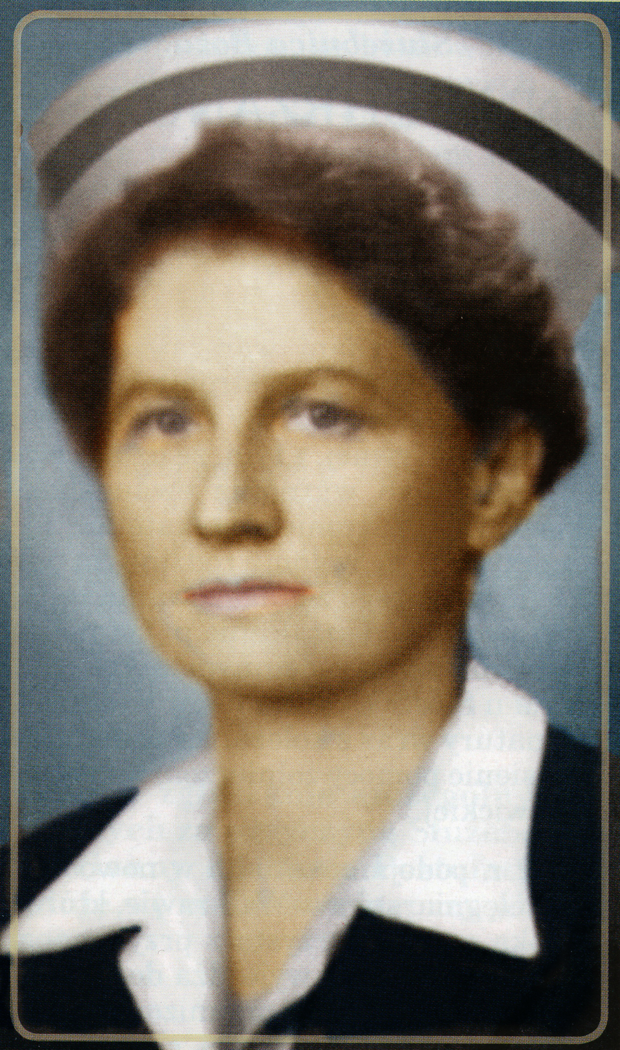
Beatification of hanna chrzanowska Lay Catholic Nurse 1902-1973
April 28, 2018
Diocese of Krakow, Poland
Presentation by Diana Ruzicka, RN, MSN, MA, MA, CNS-BC
President, National Association of Catholic Nurses, U.S.A. (2017-2018)
Pictures furnished by Geraldine McSweeney, President, International Catholic Committee of Nurses and Medico-Social Assistants and Gosia Brykczynska, author on the Life of Hanna who both participated in the beatification ceremony.
It was the first time that a professional group had petitioned the Church to canonise one of its members!
www.nacn-usa.org

Slide 2
Cause for canonization
1995-Catholic Association of Polish Nurses and Midwives submitted petition to Cardinal Franciszek Marcharski, Archbishop Krakow to open the cause
1998-Cause opened
2015-Pope Francis declares venerable
2017 July 7 – Pope Francis approves miracle attributed to her paving way for beatification
2018 April 28 – Beatification, Sanctuary of Divine Mercy, Krakow, Poland***
https://www.ncronline.org/news/people/polands-hanna-chrzanowska-set-become-first-beatified-lay-nurse
www.nacn-usa.org

Slide 3
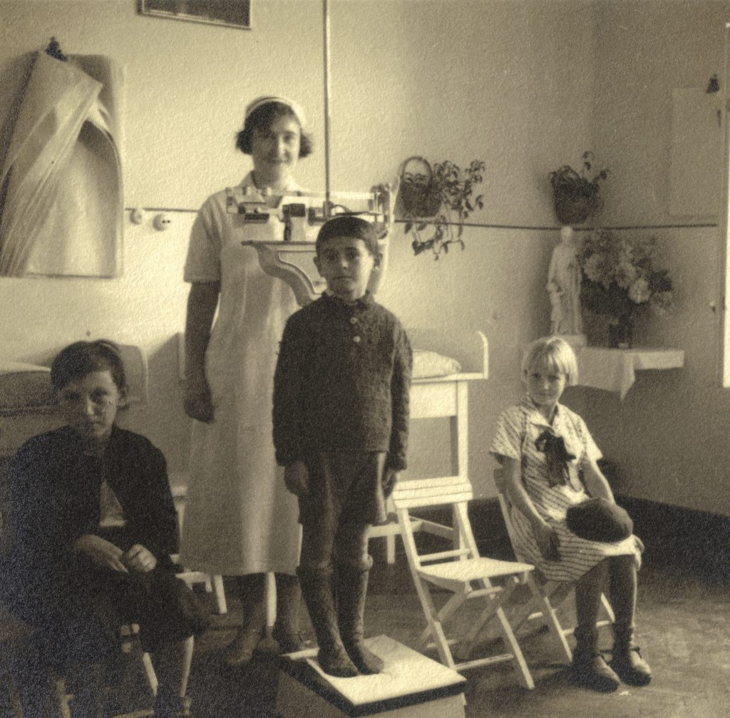
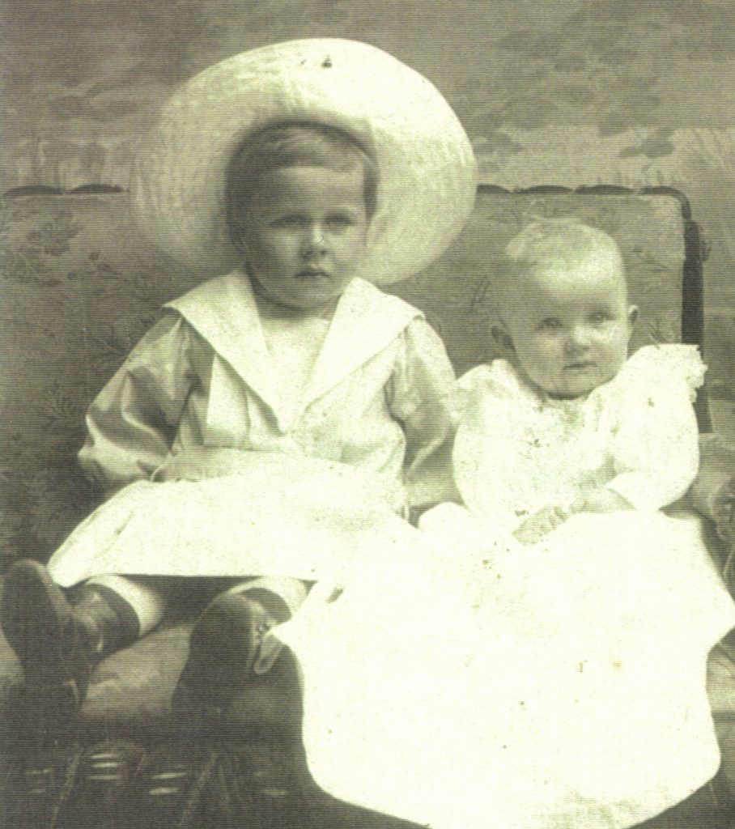
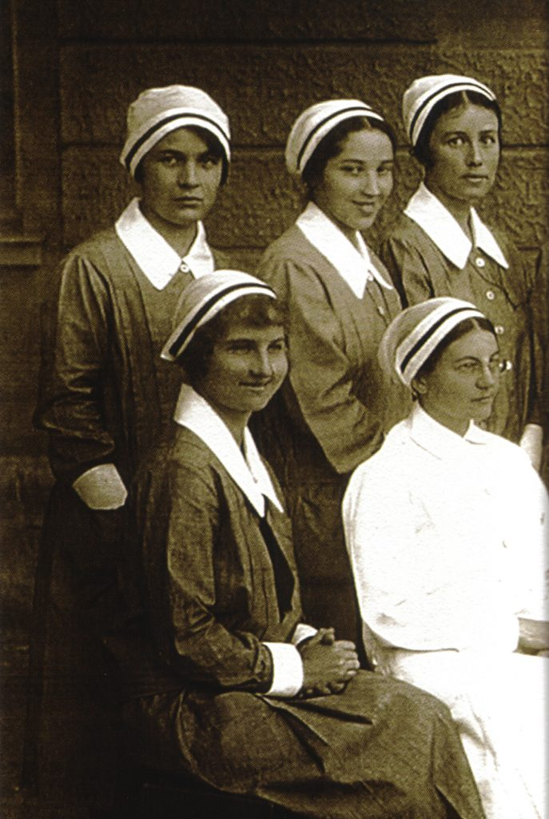
History
Born October 7, 1902 in Warsaw, Poland
1910 Moved to Krakow, High School run by Ursuline sisters
Red Cross course to help victims of the Polish Bolshevik War
1920-1924 – Warsaw School of Nursing
1924 – Studied Community Nursing in France & Belgium
1929-1939 – Edited “Polish Nurse” 1st professional nursing journal
Vice chair Polish Association of Professional Nurses
1935 – Actively participated in preparing 1st Nursing Act
1937 – Formation of the Catholic Union of Polish Nurses
1940 Father died in Sachsenhausen concentration camp
1940 – Brother, Soviet POW, killed in Katyn woods by Soviet troops
Bogdan & Hanna Chrzanowska
School of Nursing
1928
Hanna (front left)
https://hannachrzanowska.pl/en/sample-page/
www.nacn-usa.org

Slide 4
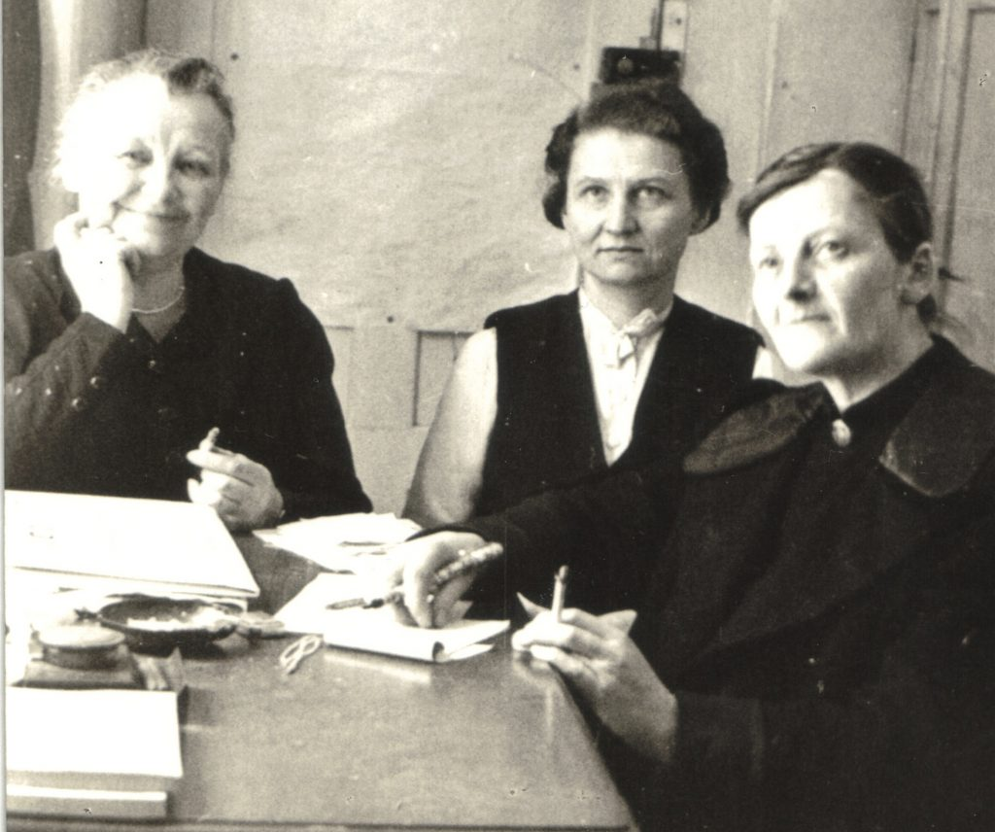
Gospel inspired heroic love of neighbor During WWII:
Care of refugees, prisoners and displaced persons
Care of orphans, including Jewish children, finding foster families and safe shelters
Organized summer-camps outside Krakow for youngsters
Established food and milk banks for starving children
Worked tirelessly, frequently risking her health and life
Hanna (center) during WWII in Krakow, with Roza Lubienska & Maria Starowiejska her co-workers in the Welfare Committee
https://hannachrzanowska.pl/en/sample-page/
www.nacn-usa.org

Slide 5
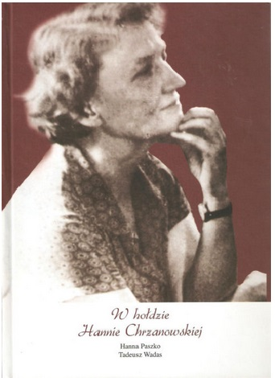
After WWII
Head Dept of Community Nsg, Krakow School of Nursing
Scholarship to USA – community & home nursing
Taught nursing teachers on community health, Warsaw
Emphasized educating young nurses in a spirit of authentic service to the sick, treating patients with dignity and paying attention to physical and spiritual needs
1956 – became a Benedictine Oblate of Tyniec Abbey
1957 fired and moved to director Psychiatric School of Nursing in Kobierzyn, outside Krakow
School closed – took an early retirement
Hanna
1957
https://hannachrzanowska.pl/en/sample-page/
www.nacn-usa.org

Slide 6
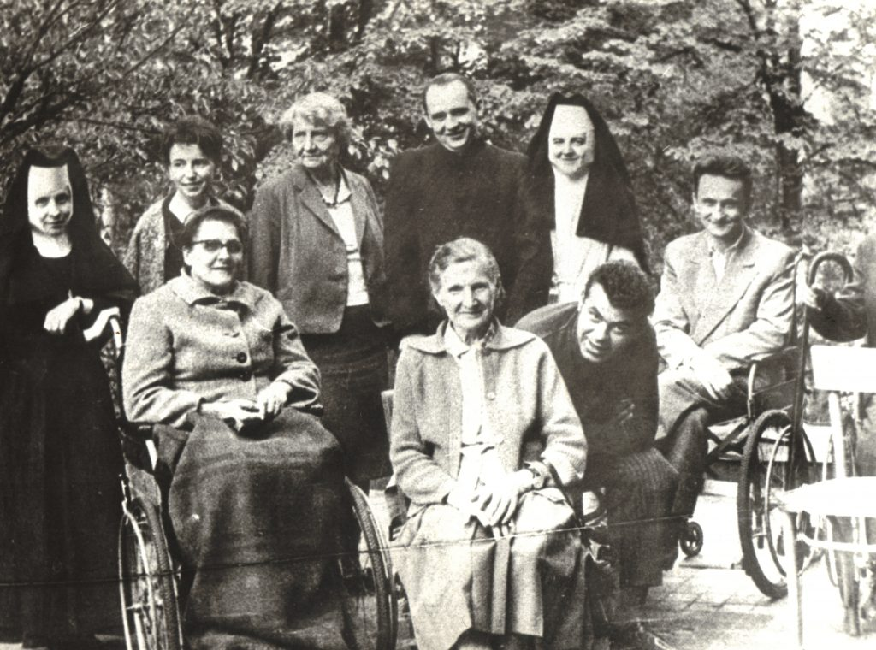
After “Retirement”
Organized professional nursing care for lonely,
abandoned, elderly or disabled and chronically sick
independent of the inefficient socialist health care
system. (Krakow Parish Nsg)
Supported by nuns, students, family and neighbors.
Pioneer of Hospice in Poland
Organized holidays and retreats for house-bound patients – helped them rediscover joys of life and gave them strength to bear their daily cross.
Custom of celebrating the Holy Mass in the home of the sick
Pastoral visits to the homes of the sick and housebound - Worked Closely with Priests and a Bishop (Karol Wojtyla)
Hanna Chrzanowska (center back row)
https://hannachrzanowska.pl/en/sample-page/
www.nacn-usa.org

Slide 7
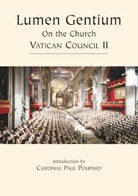
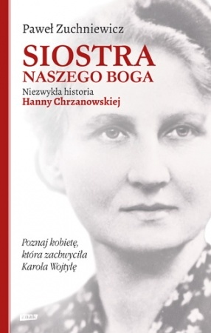
A living incarnation of Vatican ii “Universal Vocation to holiness”
Worked closely with Karol Wojtyla, 1957-1973
A lay person, a high-class professional, who draws from the depths of Christian spirituality, living in close relationship with Christ.
Realizes this relationship with Christ through service to the sick
Gradually came to realize that in caring for the sick and those who suffered, she was serving Jesus Christ Himself.
What it means to be a “Catholic” nurse
http://episkopat.pl/hanna-chrzanowska-a-lay-nurse-raised-to-the-altars/
Notes:
Priest, Archbishop and Cardinal. He would preside over her funeral in 1973.

Slide 8
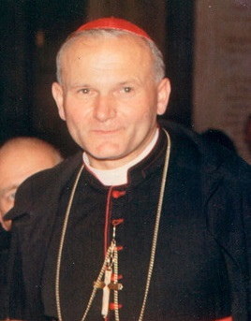
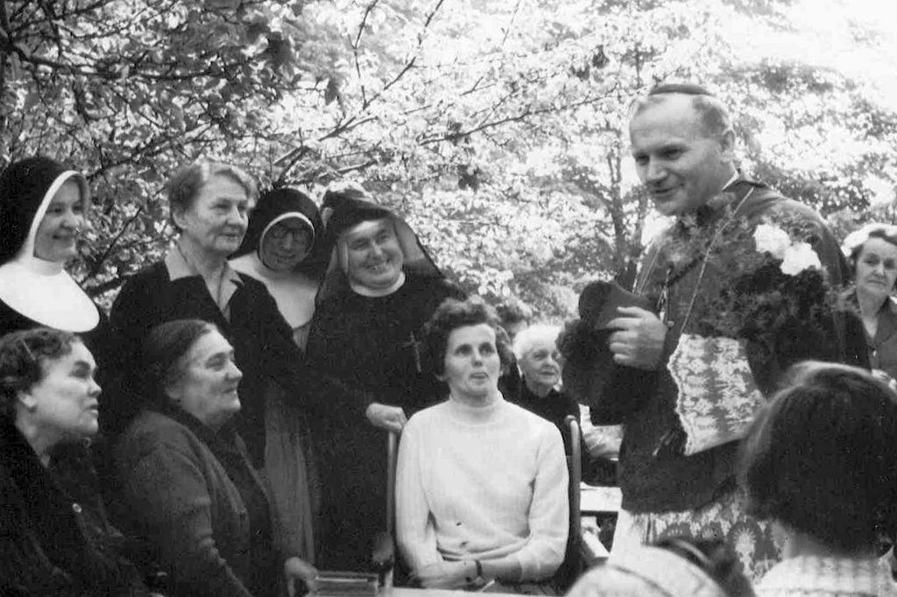
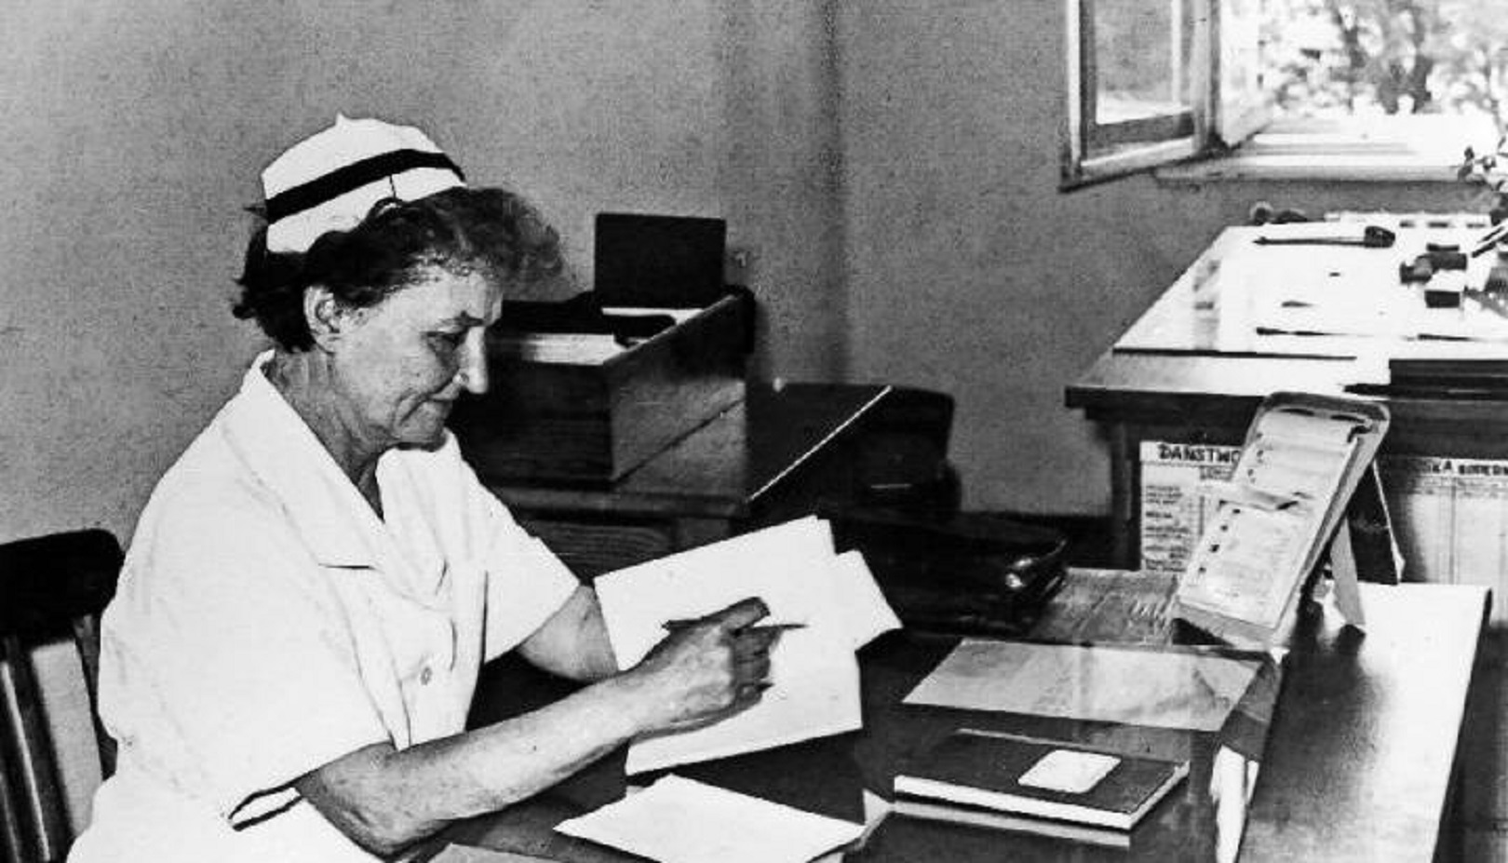
ST. John Paul II:
She was the incarnation of Christ’s blessings, “especially the one which says Blessed are the merciful.” (at her funeral)
“This is a very important matter. Watch it.” (to the postulator)
“She was always very close to my heart,” (during a meeting with the Szlenkier family, relatives of Hanna Chrzanowska)
Hanna at her desk in Krakow
Hanna with
Archbishop Karol Woytyla
http://episkopat.pl/hanna-chrzanowska-a-lay-nurse-raised-to-the-altars/

Slide 9
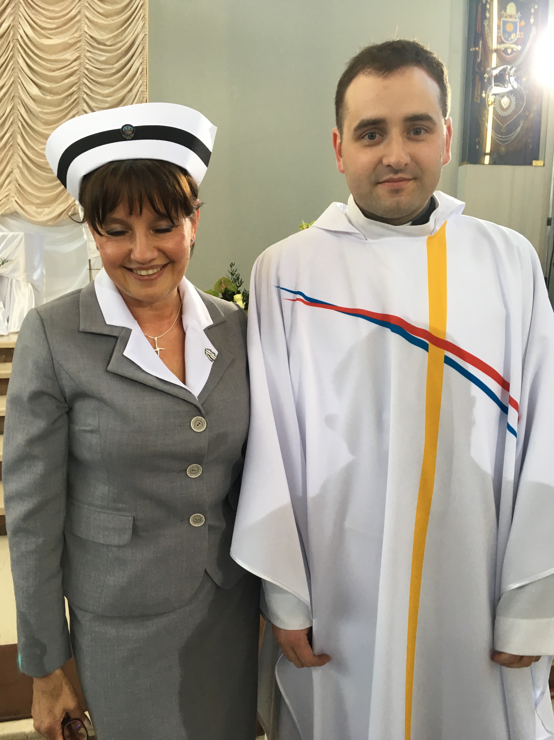
Beatification Rehearsal Night, Krakow Geraldine McSweeney, CICIAMS International President (Ireland), Marie Romagnano, RN, Founder & President of Healthcare Professionals for Divine Mercy (USA) and Tadeusz Wadas, RN, Head of the Chamber of Nurses and Midwives in Lesser, Poland.
Izabela Cwiiertnia, RN, President of the Catholic Nurses and Midwives Association in Krakow with her son who is a priest, Fr. Mieszko. Rehearsal April 27, 2018
CICIAMS=International Catholic Committee
of Nurses and Medico-Social Assistants
Notes:
Beatification Rehearsal Night - Geraldine McSweeney, CICIAMS Pres., Marie Romagnano and Tadeusz Wadas, Head of the Chamber of Nurses and Midwives in Lesser, Poland. Rehersal 4.27.2018
Izabela Cwiiertnia, President of the Catholic Nurses and Midwives Association in Krakow with her son who is a priest, Fr. Mieszko. Rehearsal 4.27.2018

Slide 10
Group of Nurses & Midwives. Midwives have red stripes on their hats
and nurses have black stripes --- At the beatification ceremony
April 28, 2018, Sanctuary of Divine Mercy, Krakow, Poland
Notes:
Group of Nurses & Midwives. Midwives have red stripes on their hats and nurses have white at the beatification, 4.28.2018

Slide 11
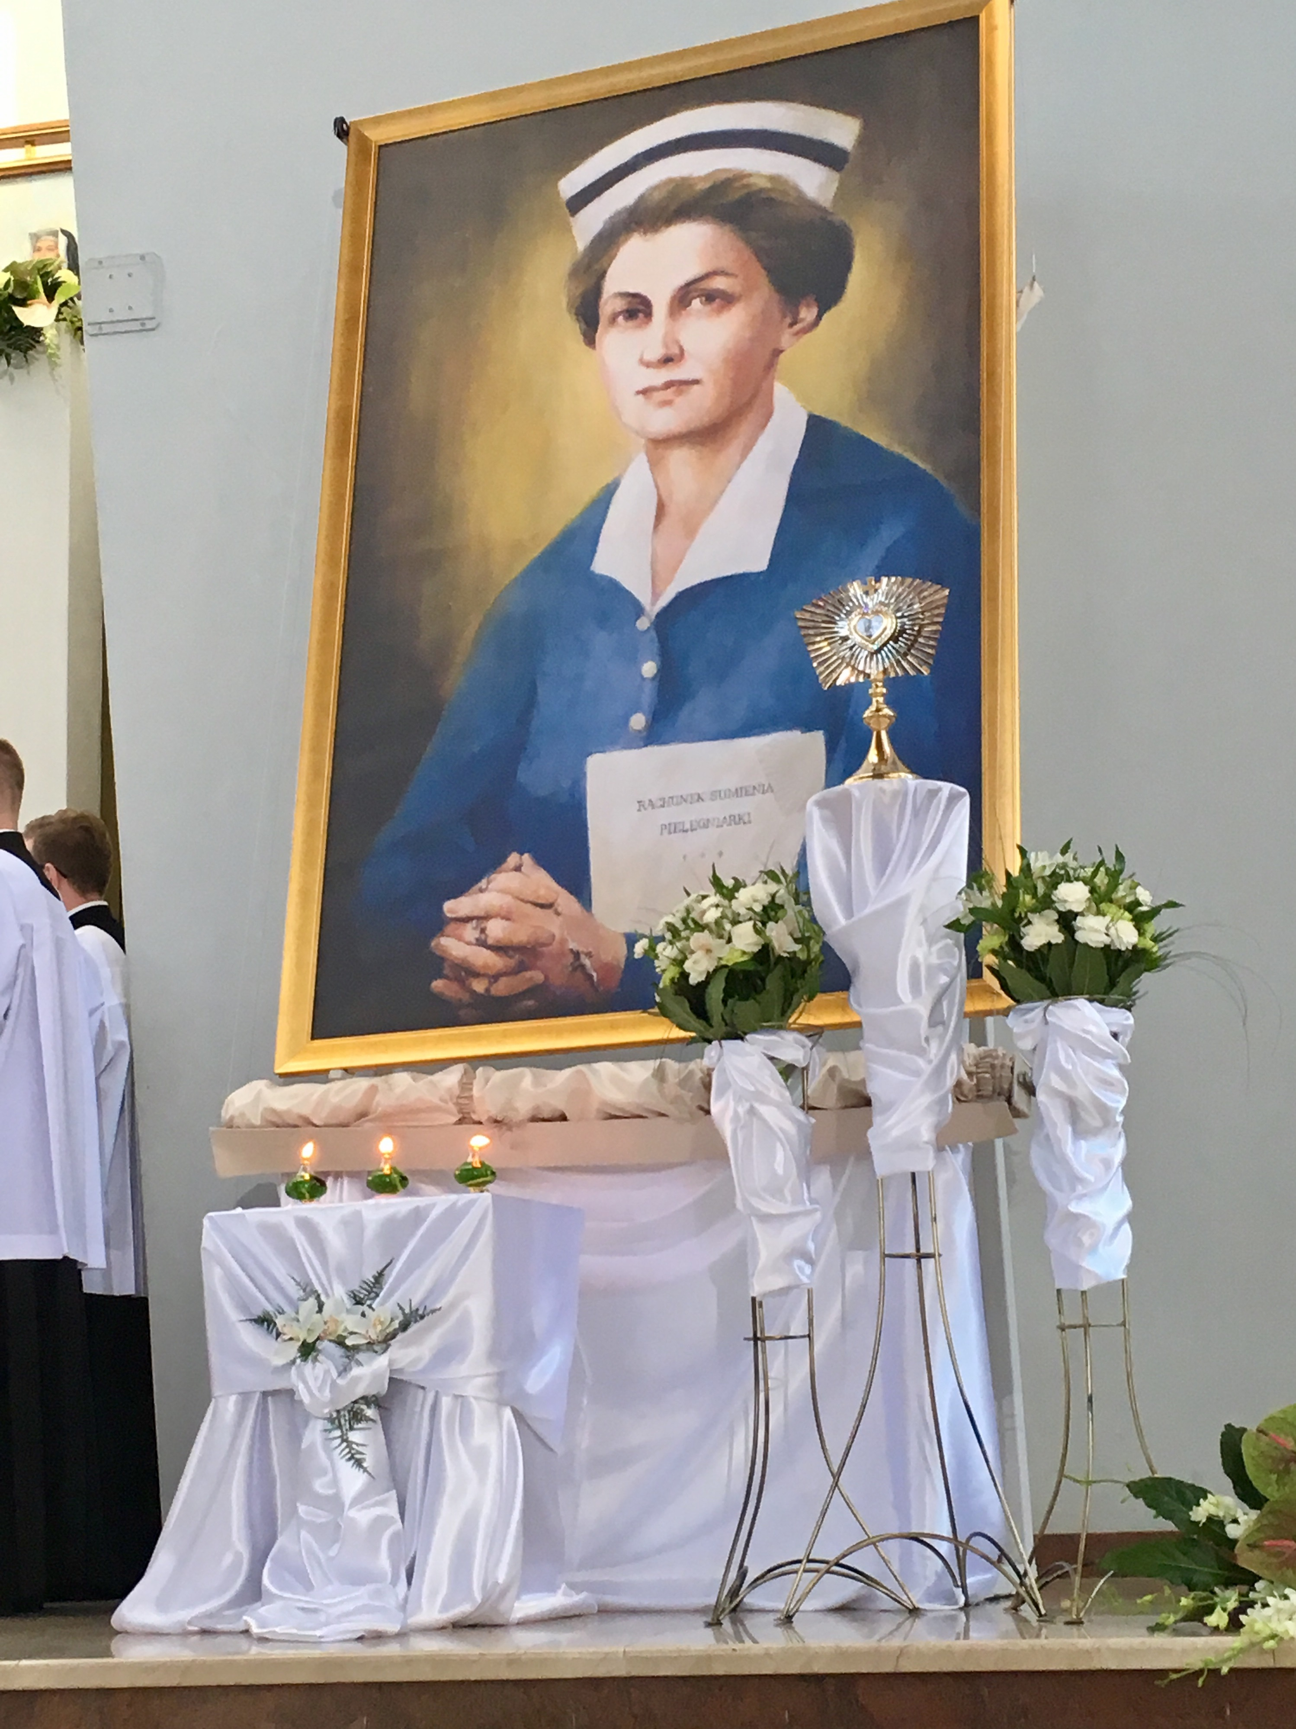
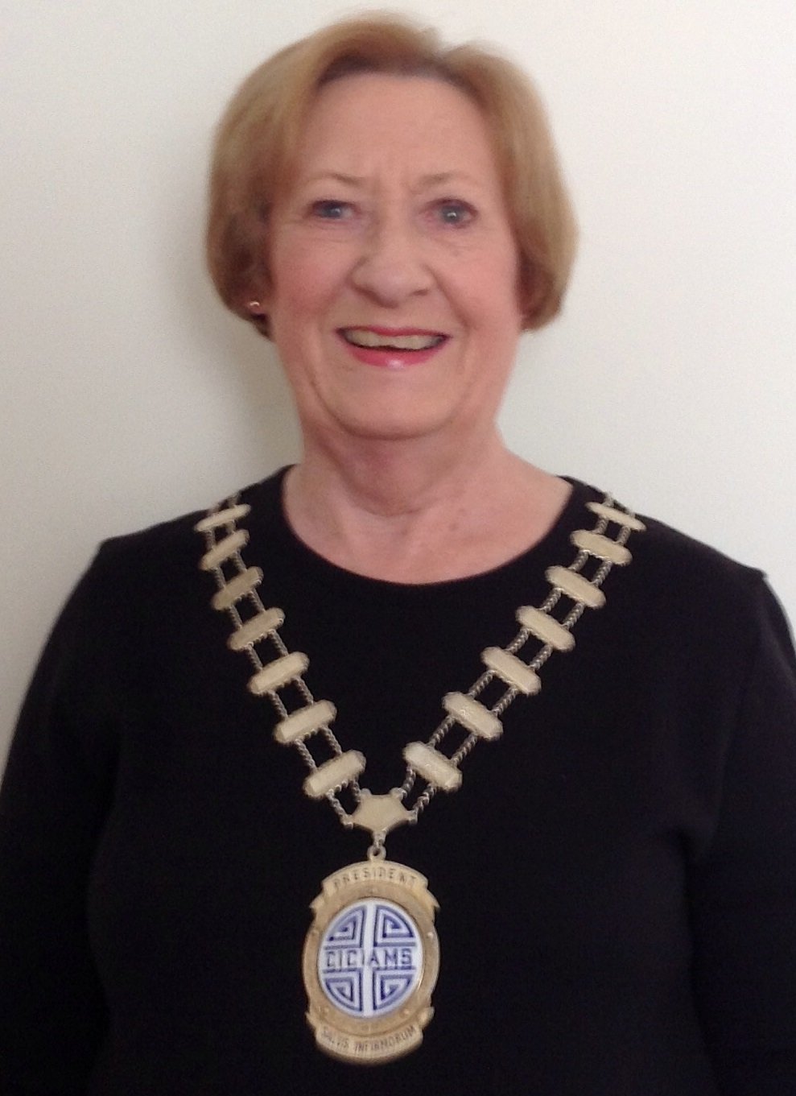
Geraldine McSweeney, CICIAMS International President carried the small lighted oil lamp behind Helena Matoga, RN (Poland), a student of Hanna’s and also the vice postulator for the cause of her canonization, who was carrying Hanna’s relics. Also carrying the lamps were Marie Romagnano, RN, Founder and President of Healthcare Professionals for Divine Mercy (USA) and Dr. Gosia Brzykczynska, PhD, RN (author of Colours of Fire: Biography of Hanna Chrzanowska – a wise and compassionate nurse).
From Geraldine McSweeney, CICIAMS International President, “The ceremony today [Saturday, April 28, 2018] was fantastic — so joyful and spiritual. There was music and clapping as we walked the length of the Basilica. The Polish nurses were to be awed — they did such great work. There were hundreds of them there in dress uniform which they wear on special occasions. Hundreds of clergy con-celebrated the Mass, the Chief Celebrant was Cardinal Angelo Amato, Prefect for the Causes of Persons for Canonization. He, of course, bestowed the blessed honor. The choir was beautiful, their singing would lift you to heaven! There were thousands in the grounds the Basilica where the ceremony was relayed on giant screens.”
Notes:
Beatification Rehearsal Night - Geraldine McSweeney, CICIAMS Pres., Marie Romagnano and Tadeusz Wadas, Head of the Chamber of Nurses and Midwives in Lesser, Poland. Rehersal 4.27.2018
Izabela Cwiiertnia, President of the Catholic Nurses and Midwives Association in Krakow with her son who is a priest, Fr. Mieszko. Rehearsal 4.27.2018

Slide 12
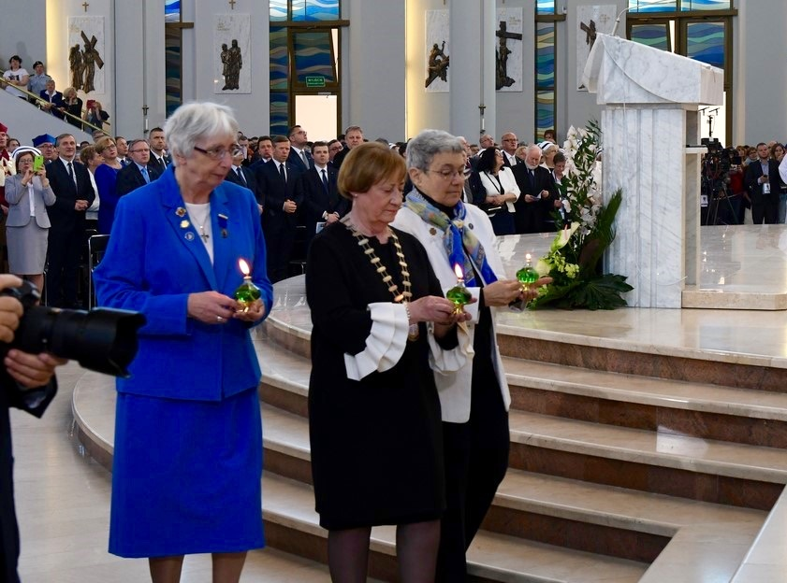
Geraldine McSweeney, CICIAMS International President (center) followed by Gosia Brykczynska, PhD, RN (blue) and Marie Romagnano, RN carrying lamps behind the relics of Hanna Chrzanowska Lay Catholic nurse
April 28, 2018
Sanctuary of Divine Mercy, Krakow, Poland
CICIAMS=International Catholic Committee of Nurses and Medico-Social Assistants
Notes:
Group of Nurses & Midwives. Midwives have red stripes on their hats and nurses have white at the beatification, 4.28.2018

Slide 13
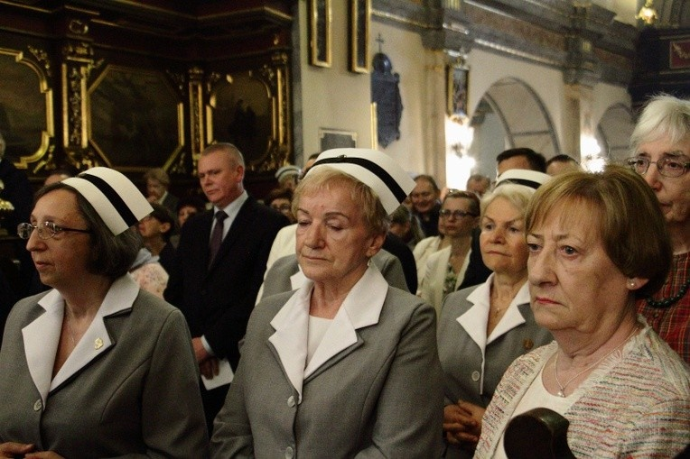
A presentation of flower made to Helena Matoga, RN, student of Hanna Chrzanowska, and Vice Postulator of Hanna’s cause, at the end of the Thanksgiving Mass - behind Dr. Gosia Brykczynska, PhD, RN & Geraldine McSweeney, CICIAMS International President
Geraldine McSweeney, CICIAMS International President at the Thanksgiving Mass in St. Nicholas Church with Helena Matoga, RN to her right April 29, 2018

Slide 14
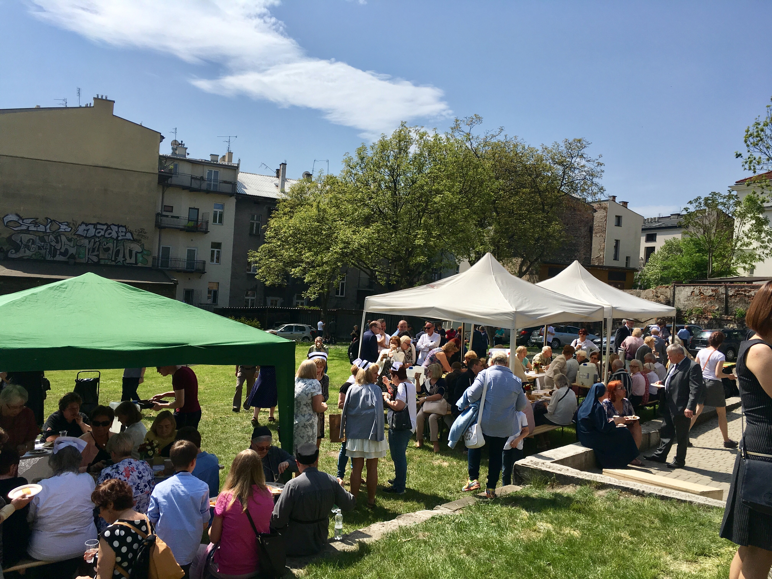
The School of Nursing in Krakow where Hanna Chrzanowska taught
The Picnic grounds of St. Nicholas Church

Slide 15
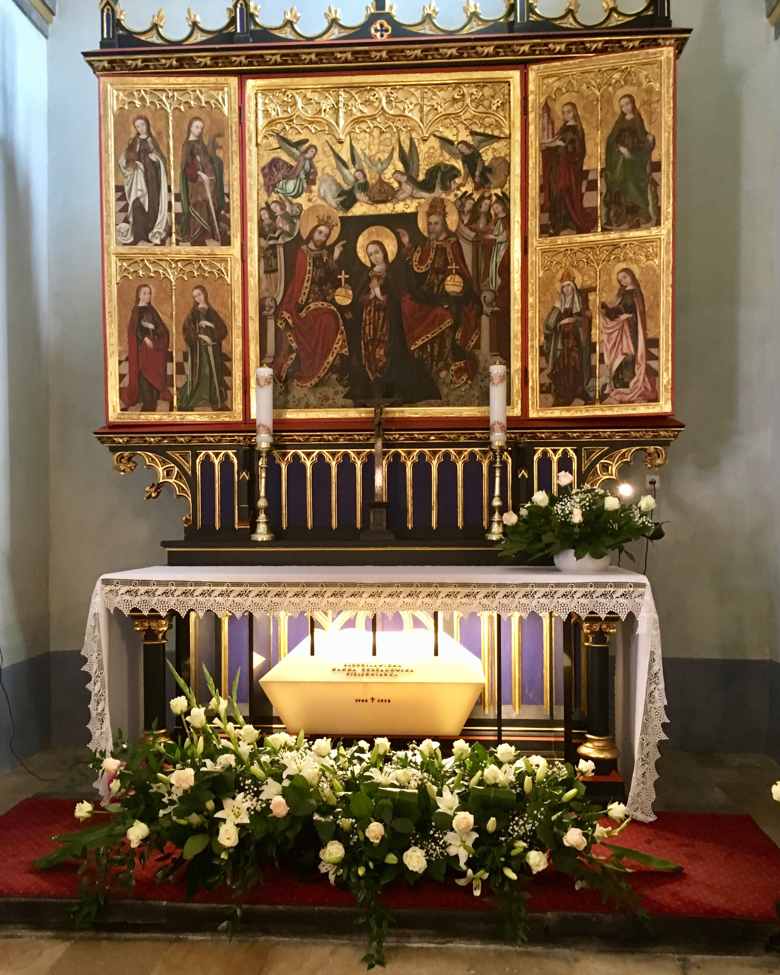
The side Altar with Hanna Chrznowska's remains in the sarcophagus
The Main Altar in St. Nicholas Church (the Nurses Church)

Slide 16
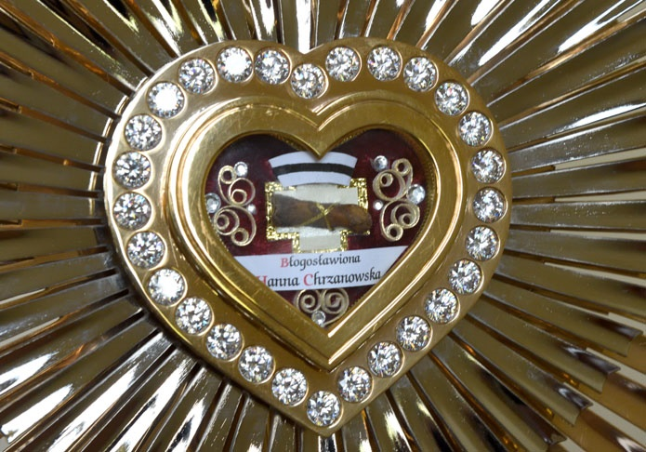
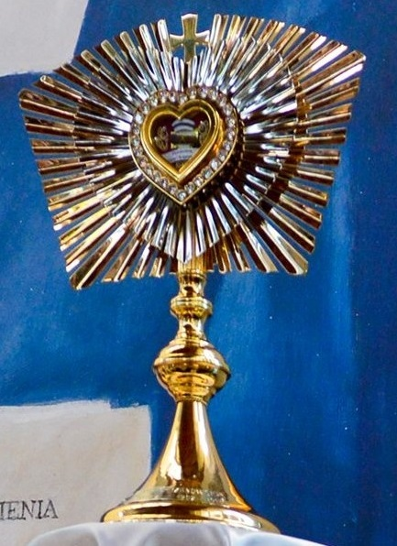
Relics of Blessed Hanna Chrzanowski, RN
Lay Catholic Nurse
Beatified in Krakow, Poland, April 28, 2018

Slide 17
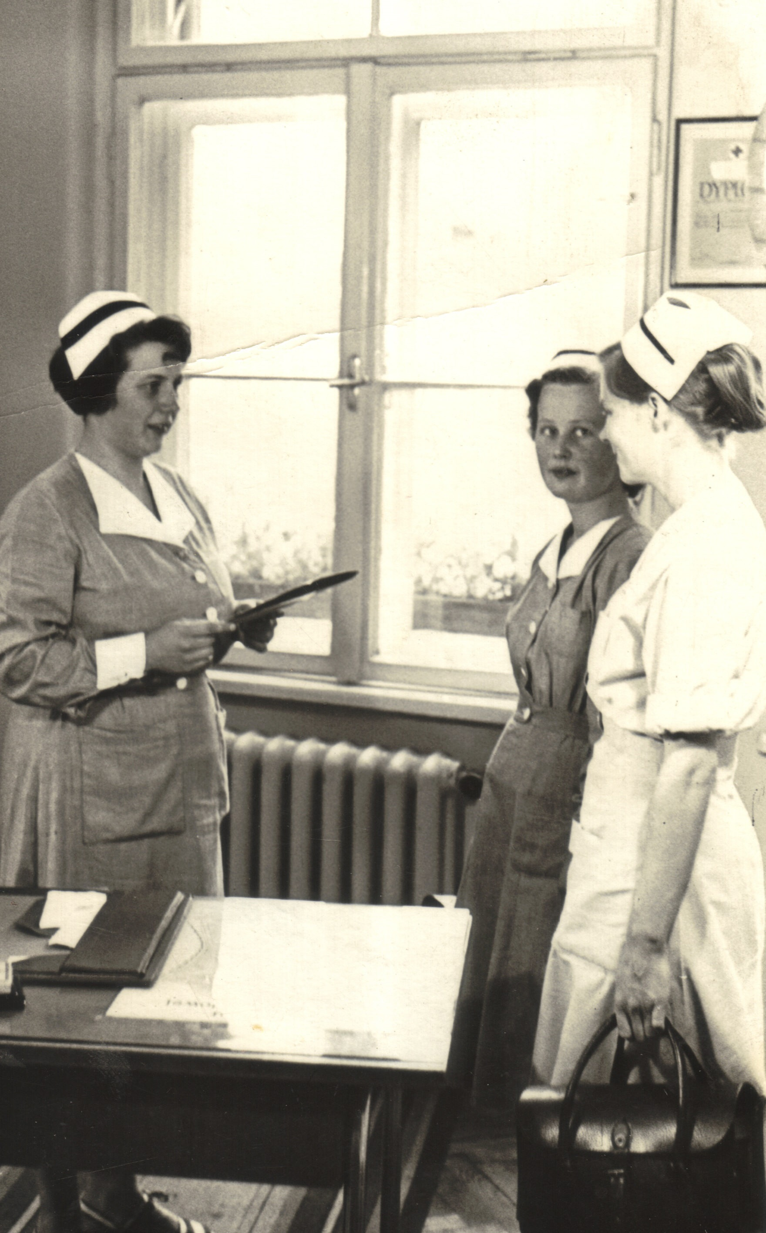
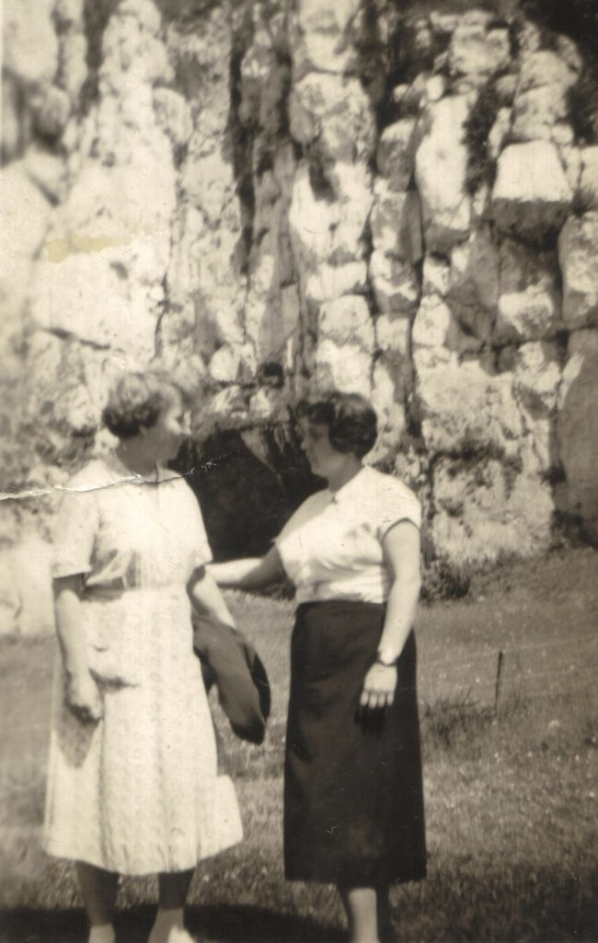
Miracle #1
Zofia Szledak-Cholewinska, friend and nurse
Ruptured non-medically and non-surgically treatable aneurysm of the brain – 2001
Coma x 6 weeks then no evidence of cerebral trauma. Full use of her limbs and speech
Doctors had no explanation for her cure
The Rest of the Story – Both physical life saved and her soul
Zofia Szledak, student of
Bl. Hanna and an Instructor of Community Nursing, Krakow School of Nursing, Poland
Hanna and Zofia
at Tyniec Abbey, Poland
www.nacn-usa.org
Notes:
The miracle that led to the opening of Hanna's cause to being declared Blessed was the miraculous recovery of her friend and nurse, Zofia Szledak-Cholewinska, from a ruptured non-medically and non-surgically treatable aneurysm of the brain. This happened in 2001. Zofia remained in a coma for six weeks after which she recovered with no evidence of cerebral trauma. She had full use of her limbs and speech. The doctors had no explanation for her cure.
There is more to this story. Zofia had lost and was not practising her faith many decades earlier. As I understand this happened when Blessed Hanna was still alive but the friendship continued. Some time before Zofia lost consciousness she visited Hanna's grave during which she got an urge to recite the Our Father. However, she could not remember the words and began to cry and shouted 'Hanna save me'. Zofia reported that just as she was losing consciousness that Hanna reassured her that she would be alright.
After Zofia's recovery she asked to be brought to the hospital chapel and cried throughout the length of Mass. So, not only was her physical life saved but also her soul.

Slide 18
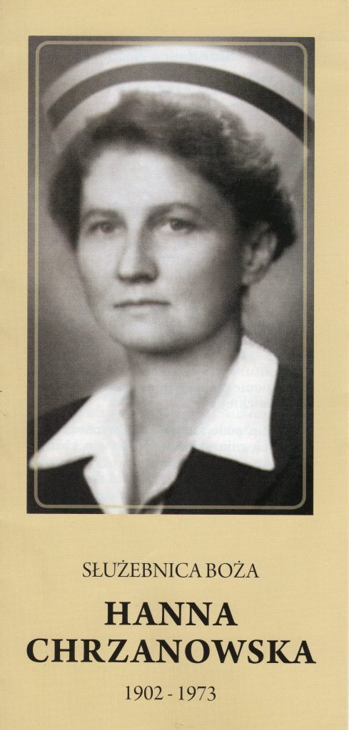
prayer
God, who in a special way called your servant Hanna Chrzanowska to the service of the sick, poor and abandoned, grant that she who answered your call with all her heart, should be counted among the saints while encouraging us with her example to bring help to our neighbours. Through her intercession grant us the grace… for which we pray in faith and hope. Through Jesus Christ our Lord. Amen. Our Father… Hail Mary… Glory be…
Please keep us informed about graces obtained through the intercession of Blessed Hanna Chrzanowska at the Postulator’s Office: Parafia Sw Mikolaja, 31-034 Krakow, Kopernica 9
https://hannachrzanowska.pl/en/sample-page/
www.nacn-usa.org

Slide 19
Author of Colours of Fire: The Life of Hanna Chrzanowska
Dr. Gosia Brykczynska, PhD, RN
Contact for speaking engagements at: Gosia.Brykczynska@talktalk.net
Text available at www.amazon.com
Will be present at the National Association of Catholic Nurses, U.S.A. National Meeting, August 2-3, 2018 in San Antonio, Texas (Register at www.nacn-usa.org)
Holy Cards in English will be available from the Shrine of Divine Mercy
http://www.thedivinemercy.org/
www.nacn-usa.org

